Slide 1
Sampling Methods
Bahrani S. MD.
Cardiology Resident

Slide 2
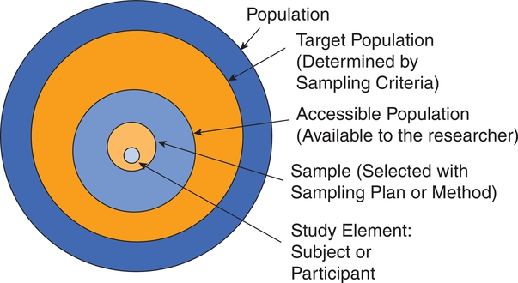
Target Population

Slide 3
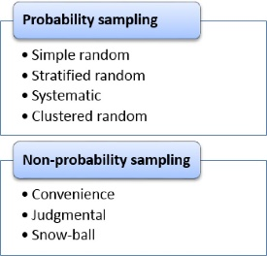
Sampling Types

Slide 4
Probability sampling
All subjects in the target population have equal chances to be selected in the sample

Slide 5
Simple random

Slide 6
Stratified random

Slide 7
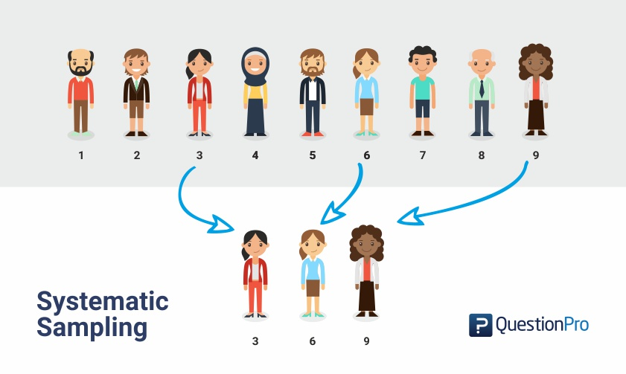
Systematic random (Interval sampling)

Slide 8
Cluster sampling (Multistage sampling)

Slide 9
Non-probability Sampling
Sample population is selected in a non-systematic process that does not guarantee equal chances for each subject in the target population

Slide 10
Convenience

Slide 11
Judgmental

Slide 12
Snow-ball

